Slide 1
JAY BHANUSHALI VINIT PAWASKAR SIDDHESH OTARI BHUWAN GUPTA ORVAL PERRIERA

Slide 2

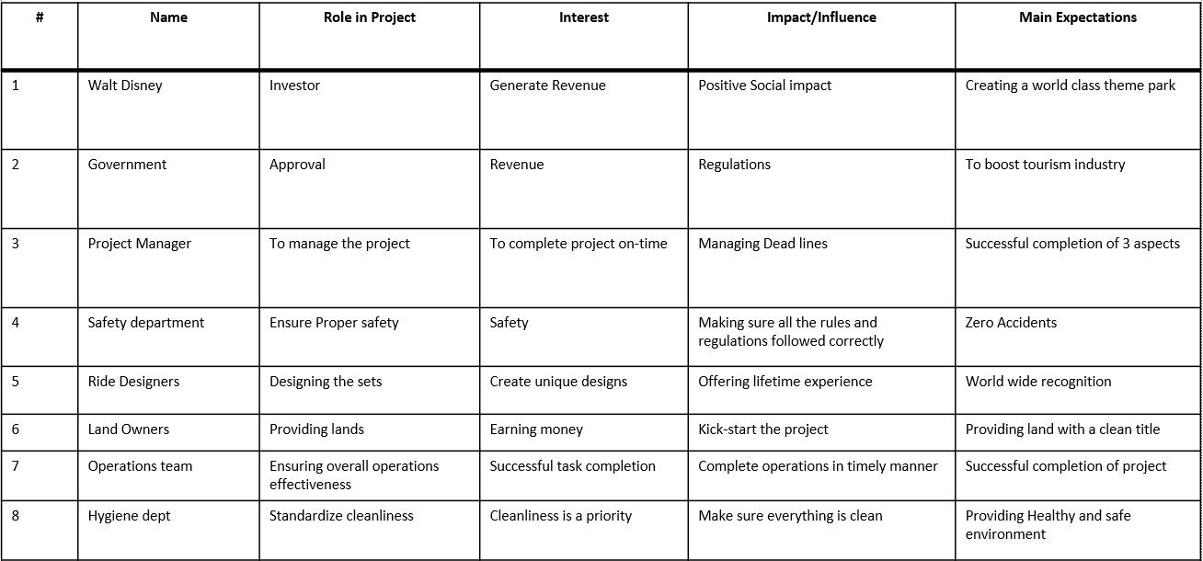

Slide 3
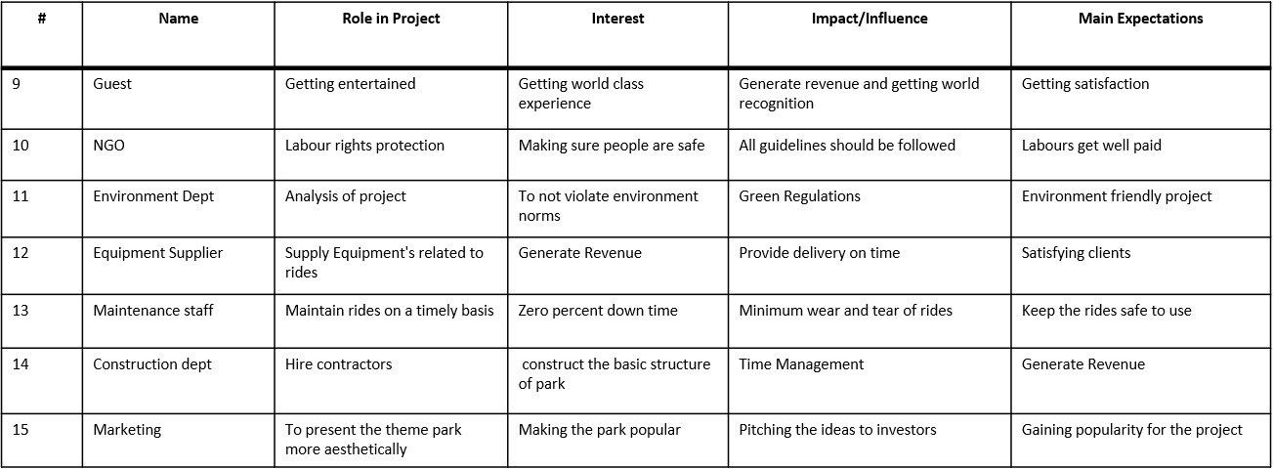

Slide 4

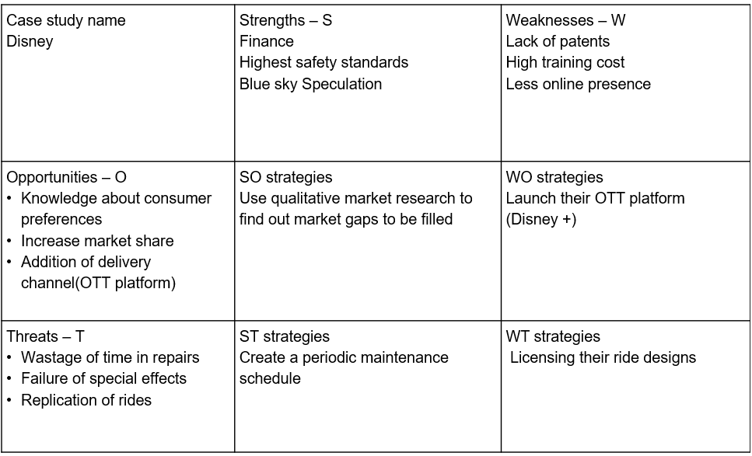

Slide 5

Sr. no | Stakeholder Name | Power | Interest
1 | WALT DISNEY | 10 | 10
2 | GOVERNMENT | 9 | 4
3 | PROJECT MANAGER | 9 | 9
4 | SAFETY DEPARTMENT | 10 | 8
5 | RIDE DESIGNER | 6 | 8
6 | OPERATION TEAM | 8 | 9
7 | ENVIRONMENT DEPARTMENT | 8 | 8
8 | GUESTS | 2 | 4
9 | NGO | 3 | 4
10 | HYGIENE DEPARTNEMENT | 4 | 4
11 | EQUIPMENT SUPPLIER | 3 | 3
12 | MAINTAINENCE | 4 | 6
13 | CONSTRUCTION DEPARTMENT | 7 | 7
14 | MARKETING TEAM | 4 | 8
 | CHART AXIS | 5 | 5

Slide 7

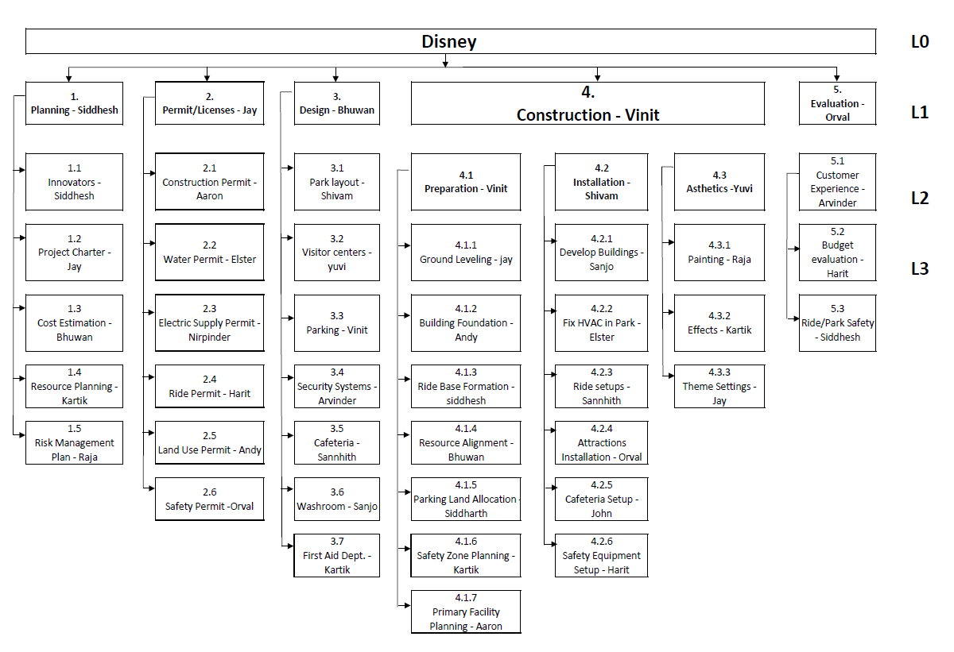

Slide 8

WBS Item | Work Item | Siddhesh | Jay | Raja | Bhuwan | Kartik | Aaron | Elster | Andy | Orval | Shivam | Yuvi | Vinit | Arvinder | Sannhith | Sanjo | Siddharth | Harit | John
1 | PLANNING | P | S |  |  |  |  |  |  |  |  | S
1.1 | INNOVATORS | P |  |  |  | S |  |  |  |  |  |  |  |  |  |  | S
1.2 | PROJECT CHARTER |  | P |  |  |  |  |  |  | S |  |  |  |  | S
1.3 | COST ESTIMATION |  |  |  | P |  | S |  |  |  |  |  |  | S
1.4 | RESOURCE PLANNING |  |  |  |  | P
1.5 | RISK MANAGEMENT |  |  | P |  |  |  |  |  | S |  |  |  |  |  |  |  |  | S
2 | PERMIT/LICENSES |  | P |  | S |  |  |  |  |  |  |  |  | S
2.1 | CONSTRUCTION PERMIT |  | S |  |  |  | P |  |  |  |  |  |  |  |  |  | S
2.2 | WATER PERMIT | S |  |  |  |  |  | P |  |  | S
2.3 | ELECTRIC SUPPLY PERMIT |  |  |  |  | S |  |  | P |  |  |  | S
2.4 | RIDE PERMIT |  |  | S |  |  |  |  |  | S |  |  |  |  |  |  |  | P
2.5 | LAND USE PERMIT |  |  |  |  |  | S |  | P |  |  |  |  |  |  |  |  |  | S
2.6 | SAFETY PERMIT |  |  |  | S |  |  |  |  | P |  |  |  |  |  | S
3 | DESIGN |  |  |  | P |  | S | S
3.1 | PARK LAYOUT |  |  | S |  |  |  |  |  |  | P |  |  |  | S
3.2 | VISITOR CENTERS |  |  |  |  | S |  |  |  |  |  | P |  |  |  |  | S
3.3 | PARKING |  |  |  |  |  |  |  |  |  |  |  | P
3.4 | SECURITY SYSTEMS |  |  |  |  | S |  |  |  | S |  |  |  | P
3.5 | CAFETERIA |  |  |  |  |  | S |  |  |  |  |  |  |  | P
3.6 | WASHROOM |  |  |  |  |  |  | S |  |  |  | S |  |  |  | P
3.7 | FIRST AID DEPT. |  |  |  |  | P |  |  |  | S |  |  |  |  |  |  |  | S
4 | CONSTRUCTION |  |  | S |  |  |  | S |  |  |  |  | P
4.1 | PREPARATION |  | S |  |  |  | S |  |  |  |  |  | P
4.1.1 | GROUND LEVELING |  | P |  |  | S |  |  |  |  |  |  | S
4.1.2 | BUILDING FOUNDATION |  |  |  | S |  |  |  | P |  | S
4.1.3 | RIDE BASE FORMATION | P |  |  |  | S |  |  |  |  |  |  | S
4.1.4 | RESOURCE ALIGNMENT |  |  | S | P | S
4.1.5 | PARKING LAND ALLOCATION |  |  | S |  |  |  |  |  |  |  |  |  |  |  |  | P | S
4.1.6 | SAFETY ZONE PLANNING |  |  |  |  | P |  |  | S |  |  |  |  |  | S
4.1.7 | PRIMARY FACILITY PLANNING |  |  | S |  |  | P | S
4.2 | INSTALLATION |  |  |  |  |  |  |  | S |  | P |  |  | S
4.2.1 | DEVELOP BUILDINGS | S |  |  |  |  |  |  | S |  |  |  |  |  |  | P
4.2.2 | FIX HVAC IN PARK |  |  |  |  |  |  | P |  |  |  | S |  |  |  |  |  | S
4.2.3 | RIDE SETUPS |  |  |  | S |  |  |  |  |  | S |  |  |  | P
4.2.4 | ATTRACTIONS INSTALLATIONS |  |  |  |  | S |  |  |  | P |  |  | S
4.2.5 | CAFETERIA SETUP |  |  |  |  |  |  |  |  | S |  |  |  | S |  |  |  |  | P
4.2.6 | SAFETY EQUIPMENT SETUP |  |  |  |  |  |  |  | S |  |  |  | S |  |  |  |  | P
4.3 | AESTHETICS |  |  |  |  |  |  |  |  |  |  | P
4.3.1 | PAINTING |  |  | P |  |  | S |  |  |  | S
4.3.2 | EFFECTS |  |  |  |  | P |  |  | S |  |  |  |  |  |  | S
4.3.3 | THEME SETTINGS |  | P |  |  |  |  | S |  |  |  |  | S
5 | EVALUATION |  |  |  | S |  |  |  |  | P | S
5.1 | CUSTOMER EXPERIENCE |  |  |  |  |  |  |  |  |  |  |  | S | P | S
5.2 | BUDGET EVALUATION |  |  |  |  |  |  |  |  |  |  |  |  |  | S |  | S | P
5.3 | RIDE/PARK SAFETY | P |  |  |  | S |  |  |  |  |  | S

Slide 9

Innovation
Finalizing Design
2.1
VINIT
12
3.1
VINIT
6
START
Finalizing Idea for park
Beginning of Construction
1
VINIT
0
3
VINIT
10
4
VINIT
2
Cost Estimation
Licensing
2.2
VINIT
8
3.2
VINIT
6

Slide 10
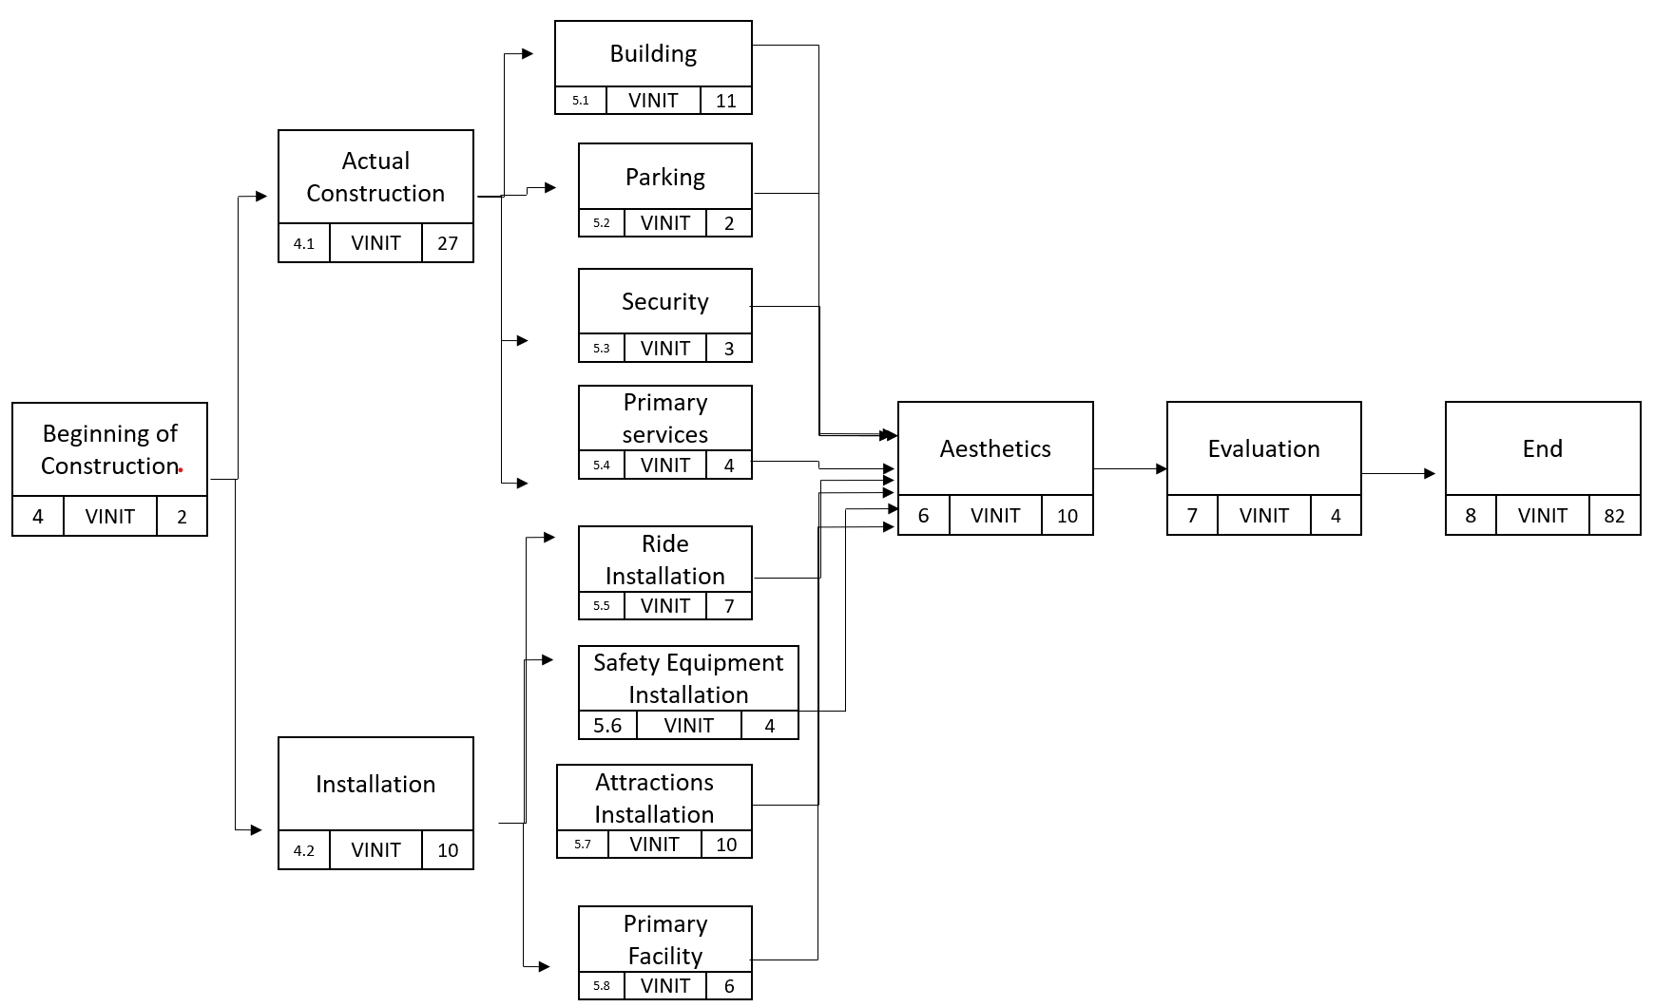

Slide 11

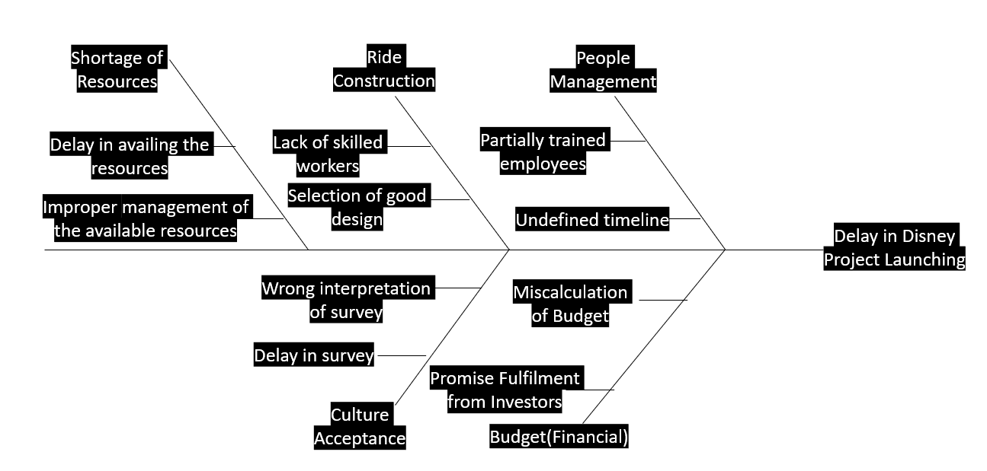

Slide 12

Why do most project managers not recognize that they either need or can use the skills required to perform as an Imagineering project manager?
Every project has its own uniqueness to it. Imagineering projects not only require unique approach but also innovative ideas to successfully complete the projects.
What is the fundamental difference between a ride and an attraction?
A ride provides first hand user experience and attraction can be enjoyed just by viewing it.
What are some of the differences between traditional brainstorming and Imagineering brainstorming?
Imagineering brainstorming helps the team to bring idea to life that can’t even be imagined.
How many project constraints are there on a traditional theme park attraction?
Time, Cost, Scope
Imagineering project : Time, Cost, Scope, Safety, Quality and Aesthetic Value
How would you prioritize the constraints?
Safety
Quality
Aesthetic Value
Scope
Time
Cost
Why is it necessary to consider cost before the Imagineering brainstorming sessions are completed?
Going over the budget may make the important safety features less feasible.

